Slide 1
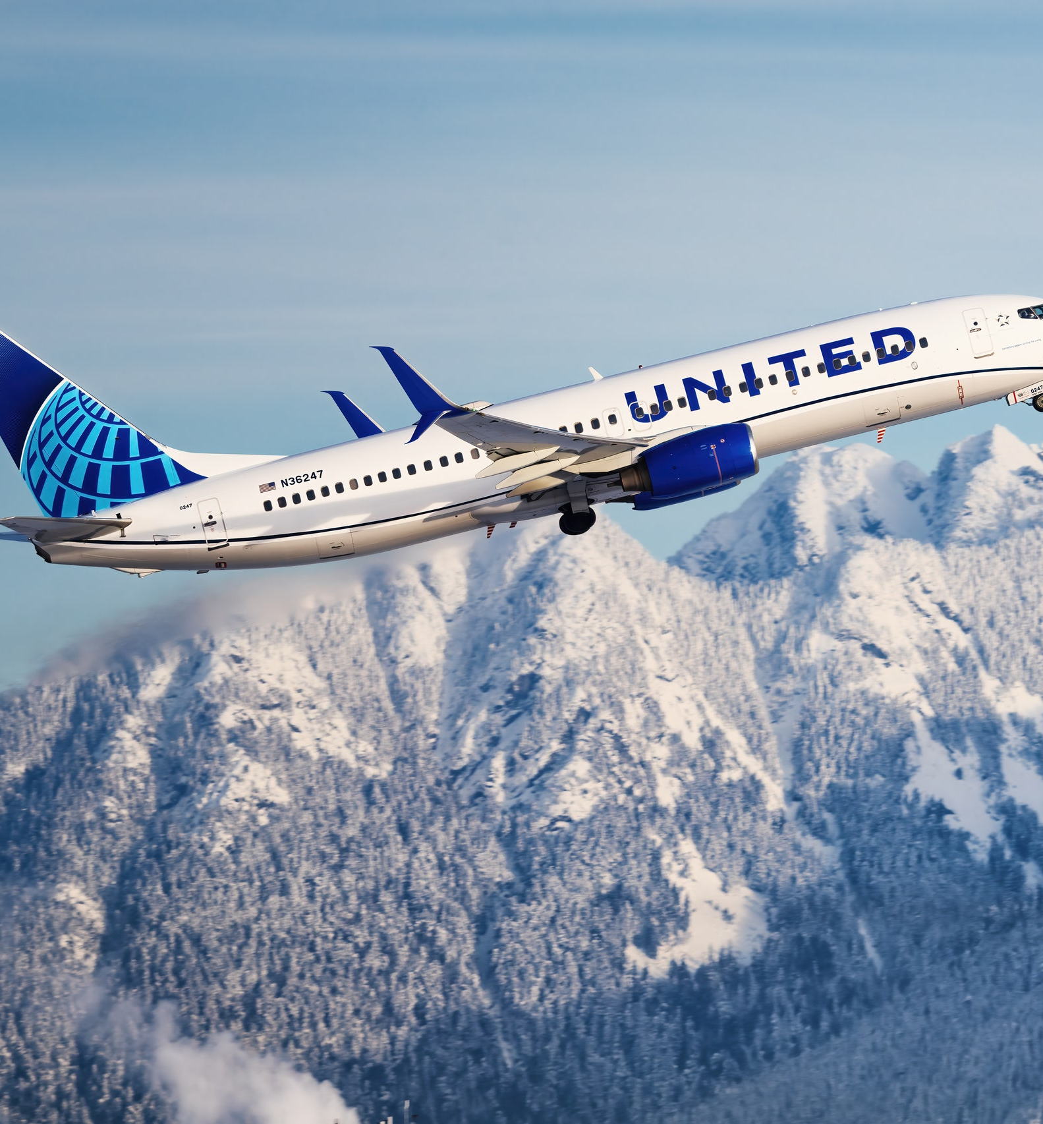
Negative Customer Sentiment due to Luggage handling.
Golden Gate University
MSBA 324 - Web & Social Network Analytics in R
Team members:
Akshay Danthi
Ryan Winston
Samhitha Subbaraju
Shibani Das
Rupesh Ganja
United Airlines
(Image reference: https://www.cntraveler.com/story/united-airlines-expansion-asia-pacific)

Slide 2
Agenda
Situation ()
Problem Statement ()
Model Selection ()
Solution Process ()
Research ()
Software ()
Model Results ()
Visualization ()
Results Interpretation ()
Situation Comparison ()
Conclusion ()
Recommendation ()
Notes:
notes

Slide 3
Situation (Part 1)
This project was inspired by our perception of United Airlines often being the subject of PR controversies and thus having a Negative sentiment among Customers. (Matousek, 2018).
We intended to analyze the Customer reviews posted on airlinequality.com to understand what pain-points United Airlines were facing; since negative Customer sentiment from Ratings and Reviews have a negative Impact on Brand Recognition, as demonstrated in the research by (Zhou, 2022), (Gopinath, S., Thomas, J., and Krishnamurthi, L. 2014) and (Al Balawi, R., Hu, Y., Qiu, L. 2022).
Notes:
notes

Slide 4
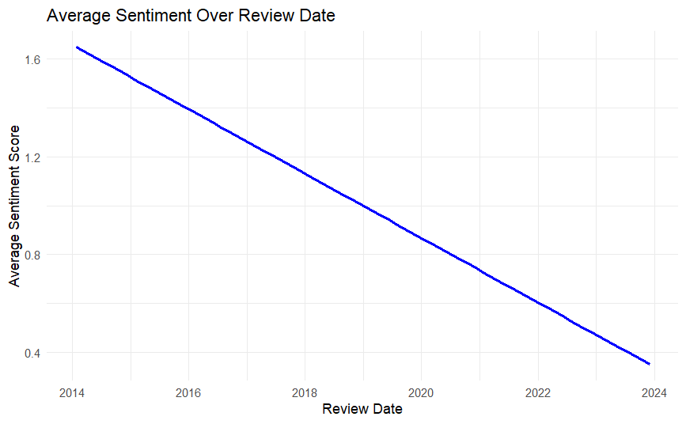
Situation (Part 2): Average customer sentiment (Syuzhet-derived) over time (Review.Date) for United Airlines

Slide 5
Problem Statement (Part - 1)
Objectives of project:
To decrease Negative sentiment due to United Airlines’ Luggage Handling issues, derived from Customer reviews on airlinequality.com website, with the intent of improving Brand Recognition. Dependent Variable:
Brand Recognition of United Airlines.
Since Customer Sentiment has a strong relationship with the variable Brand Recognition, as shown by (Zhou, 2022), (Gopinath, S., Thomas, J., and Krishnamurthi, L. 2014) and (Al Balawi, R., Hu, Y., Qiu, L. 2022), it would serve as a Proxy dependent variable here. Numerical Threshold:
Project will be successful if United Airlines is able to resolve its Luggage handling issues unique to it, in turn reducing the negative sentiment due to it, and thus increasing the Mean Overall Sentiment by 1, as determined on the Syuzhet scale, derived from reviews posted on airlinequality.com by passengers who traveled with United Airlines.

Slide 6
Problem Statement (Part – 2)
We analyzed a dataset scraped from airlinequality.com to determine the most important factors that caused negative customer sentiment in their reviews.
More specifically, we performed Sentiment Analysis and Text Mining Analysis to determine if specific keywords relating to issues unique to United had a relationship to the Sentiment.
Through our analysis, it was observed that “luggage” handling emerged as a prominent issue causing negative sentiment among United Airlines passengers. The project further aimed to compare United Airlines' luggage-related issues with that of other airlines in the same industry, specifically examining year-on-year trends. Zhou (2022) demonstrated that customer sentiment from online reviews is directly correlated with brand recognition. Therefore, it would be beneficial for United Airlines to address the unique negative feedback regarding its luggage handling issues, as this could significantly improve its Brand Recognition.
Notes:
notes

Slide 7
Model Selection – Part 1
Why we chose Sentiment Analysis and Text Mining Analysis models:
Contextual Understanding: Customer reviews are a rich source of qualitative data with nuances that extend beyond numeric values. Sentiment Analysis allows us to extract sentiment-related information, enabling us to comprehend the emotional tone and opinions expressed in the text. This is essential for deciphering the complex nature of customer feedback.
Identifying Trends: Sentiment Analysis coupled with Text Analysis helps us identify trends and patterns within our dataset. By examining the sentiment polarity of reviews over time (utilizing the "Review Date" attribute to extract the year), we unearthed a noteworthy uptick in the mentions of the word "luggage.“. This temporal analysis would have been challenging using other models.
Notes:
notes

Slide 8
Model Selection – Part 2
Relevance to Airline Industry: Our research focuses on the airline industry, which relies heavily on customer feedback for improvement. Sentiment Analysis and Text Mining are well-suited to this context, allowing us to extract actionable insights from unstructured text data.
Interpretability: Unlike some machine learning models that operate as "black boxes," Sentiment Analysis and Text Mining provide interpretable results. We can pinpoint specific words or phrases that contribute to negative sentiment, aiding in targeted recommendations for improvement.

Slide 9
Solution Process
Step 1: Collect data from Airline quality.com for Customer reviews for United Airlines, and its competing Airlines such as Delta Airlines, American Airlines, Southwest Airlines.
Step 2: Analyze customer Sentiment using Syuzhet for each review.
Step 3: Identify common pain-points for United Airlines that cause negative sentiment, via Sentiment Analysis and Text Mining Analysis.
Step 4: Identify if these pain-points are unique to United Airlines but not common to the Airlines industry.
Step 5: Provide conclusions and recommendations to United Airlines and thus improve their Customer Sentiment on AirlineQuality.com and thus improve their Brand Recognition.
Notes:
notes

Slide 10
Research
Secondary Research:
We scraped Customer reviews posted on airlinequality.com to understand what pain-points United Airlines were facing to have decreasing Customer sentiment over years.
Our dataset had 15183 records from 11-Oct-2023 to 05-Dec-2023, containing Customer reviews from United Airlines, Delta Airlines, Southwest Airlines and American Airlines, along 19 attributes: ID, Review_Title, Review Date, Verified, Review, Aircraft, Type Of Traveller, Seat Type, Route, Date Flown, Seat Comfort, Cabin Staff Service, Food & Beverages, Ground Service, Inflight Entertainment, Wifi & Connectivity, Value For Money, Recommended. Note: 4762 of these records from 24-Jan-2014 to 05-Dec-2023 belonged to United Airlines.
Other sources have been cited in-text on slides and listed on the References section.
Legitimacy: AirlineQuality.com is a website that provides a platform to airline passengers from around the world to post reviews of their air travel experience. According to its editorial policy displayed on https://www.airlinequality.com/info/editorial-policy/, It employs IP address checks when user location and user-stated location are different. When reviews do not seem legitimate, the users are requested for a copy of their boarding pass or e-ticket to verify the trip.
Notes:
notes

Slide 11
Software – Part 1 [Code snippet] FOR FULL CODE, PLEASE SEE: https://github.com/axaysd/United_Airlines_Analysis
First, we scraped the data from Airlinequality.com and saved it as a .csv file.
Then, we analyzed the Sentiment of each review using Syuzhet’s Sentiment Analysis package in R.
# Load the CSV file containing all the passenger reviews of 4 airline companies
reviews <- read.csv("Airline_Reviews.csv")
# Function to determine Sentiment and process reviews for each airline
process_airline_reviews <- function(airline_name, data) {
reviews_filtered <- subset(data, Airline.Name == airline_name)
# Using Syuzhet package, determine the sentiment of each passenger Review
reviews_filtered$sentiment <- get_sentiment(reviews_filtered$Review, method = "syuzhet")
# To obtain date in Year, month format for analysis
reviews_filtered$Review.Date <- as.Date(reviews_filtered$Review.Date, format = "%d-%b-%y")
reviews_filtered$Year <- year(reviews_filtered$Review.Date)
reviews_filtered$Month <- month(reviews_filtered$Review.Date)
reviews_filtered$Mentioned_Luggage <- as.integer(grepl("luggage", tolower(reviews_filtered$Review)))
return(reviews_filtered)
Notes:
notes

Slide 12
Software – Part 2 – [Code snippet]
Then we found out how Luggage was being mentioned with negative sentiment over the Years and found an Increasing negative sentiment trend over the years only for United Airlines:
# Function to count the "luggage" mentions in Reviews
analyze_luggage_mentions <- function(data, airline_name, color) {
luggage_mentions <- data[grep("luggage", data$Review, ignore.case = TRUE), ]
luggage_count <- luggage_mentions %>%
filter(sentiment < 0) %>%
group_by(Year) %>%
summarise(Count = n())
# Plot the Number of Times 'Luggage' Was Mentioned Negatively Per Year Over Time
ggplot(luggage_count, aes(x = interaction(Year), y = Count)) +
geom_bar(stat = "identity", fill = color) +
theme(axis.text.x = element_text(angle = 90, hjust = 1)) +
labs(title = paste("Number of Times 'Luggage' Was Mentioned Negatively Per Year Over Time for", airline_name),
x = "Year and Month",
y = "Number of Mentions")
}

Slide 13
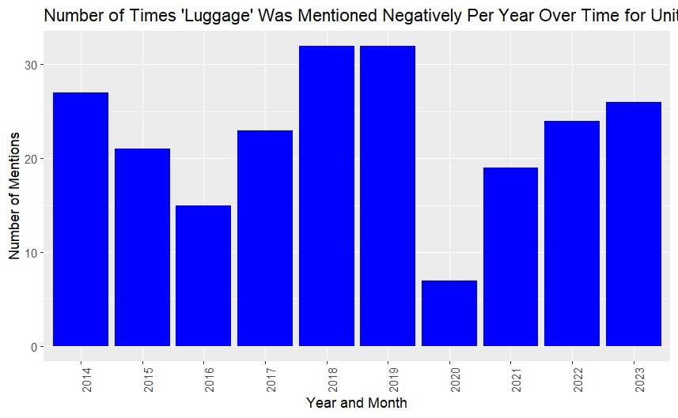
Software – Part 3 (Luggage mentions over the Years for United Airlines) – [Screenshot from R]

Slide 14
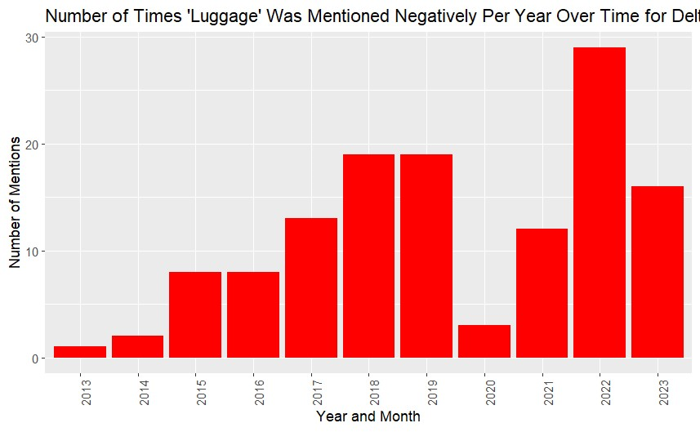
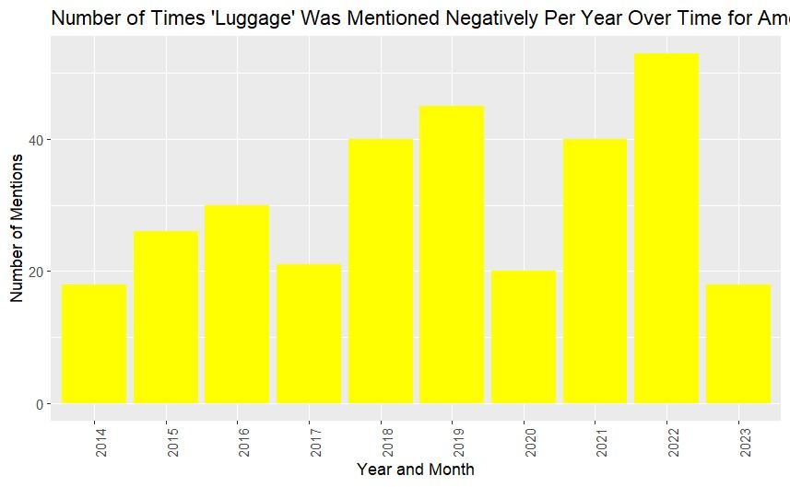
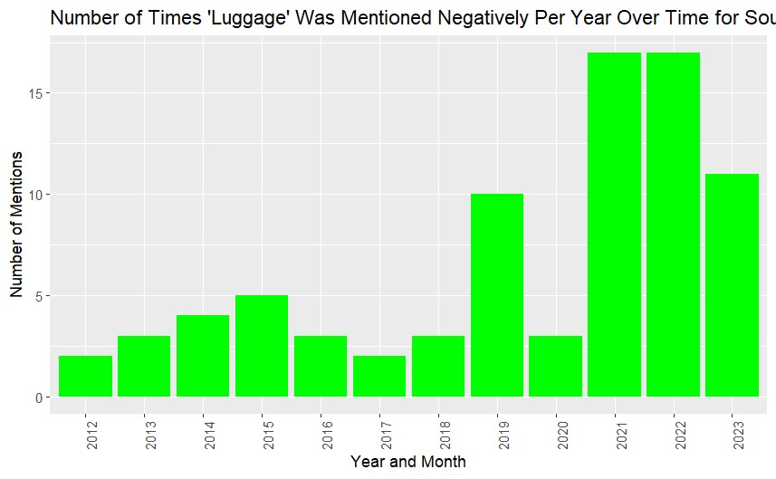
Software – Part 4 (Luggage mentions over Years for Delta vs. American vs. Southwest Airlines) – [Screenshots from R]

Slide 15
Software – Part 5 [Code snippets]
# Combine common English stopwords with custom stopwords
all_stopwords <- bind_rows(get_stopwords(), read_lines("custom_stopwords.txt") %>% tibble(word = .)) %>%
distinct(word) # Remove any duplicates
# Function to display word count for negative reviews display_word_count <- function(data) {
word_count <- data %>%
filter(sentiment < 0) %>%
unnest_tokens(word, Review) %>%
anti_join(all_stopwords, by = "word") %>%
count(word, sort = TRUE)
print(head(word_count, n = 10))
}
# Display word count for negative reviews of United Airlines
display_word_count(reviews_united)
# Compare mean ratings for mentioned and not mentioned luggage
tapply(reviews_united$Overall_Rating, reviews_united$Mentioned_Luggage, mean)
# Perform a t-test
t.test(reviews_united$Overall_Rating ~ reviews_united$Mentioned_Luggage, reviews_united = reviews_united)
# Box plot to show difference in Overall_Rating when Luggage mentioned vs. Not
boxplot(reviews_united$Overall_Rating ~ reviews_united$Mentioned_Luggage, reviews_united = reviews_united, xlab = "Luggage Mentioned? (0=No, 1=Yes)", ylab = "Overall Rating")
# Function to calculate sentiment statistics and show comparison of current Customer sentiment between each airline
calculate_sentiment_stats <- function(data, airline_name) {
current_mean_sentiment <- mean(data$sentiment, na.rm = TRUE)
data_without_negative_luggage <- data %>% filter(!(grepl("luggage", Review, ignore.case = TRUE) & sentiment < 0))
new_mean_sentiment <- mean(data_without_negative_luggage$sentiment, na.rm = TRUE)
# To show increase in sentiment for united airlines in absence of negative luggage reviews
increase_in_mean_sentiment <-new_mean_sentiment-current_mean_sentiment
cat("Current Mean Sentiment of", airline_name, ":", current_mean_sentiment, "\n")
if(airline_name == "United Airlines"){
cat("Increase in Mean Sentiment in absence of reviews containing 'Luggage' having Negative sentiment:", increase_in_mean_sentiment, "\n")
cat("Mean Sentiment in absence of Reviews containing 'Luggage' having negative sentiment:", new_mean_sentiment, "\n")}
}

Slide 16
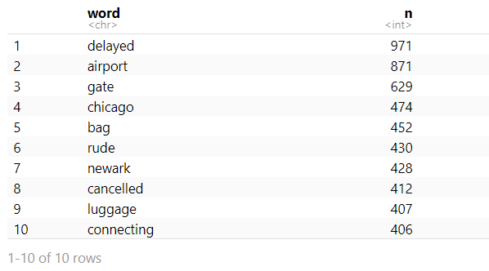
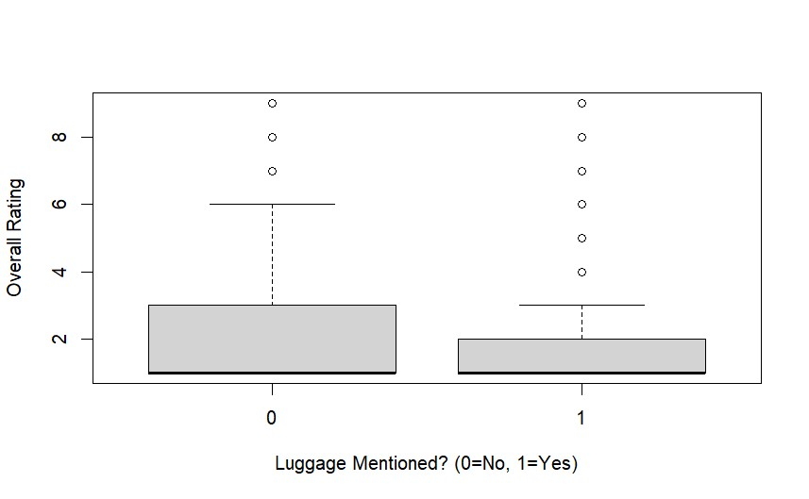
Software – Part 6 – [Screenshots from R]
Box plot of Overall_Rating when “luggage” not Mentioned vs. Mentioned
Top 10 words frequently mentioned with a negative Sentiment in reviews posted by passengers who traveled with United Airlines

Slide 17
Software – Part 7 [Code snippets]
# For Recommendations to United to resolve their Luggage issues based on Reviews:
# Filter the data for reviews mentioning Luggage and Sentiment < 0
filtered_data <- subset(reviews_united, grepl("luggage", reviews_united$Review, ignore.case = TRUE) & reviews_united$sentiment < 0)
# Read custom stop words
custom_stopwords <- readLines("custom_stopwords_luggage.txt")
# Combine with English stop words
all_stopwords <- c(stopwords("english"), custom_stopwords)
# Prepare the corpus
corpus <- Corpus(VectorSource(filtered_data$Review))
corpus <- tm_map(corpus, content_transformer(tolower))
corpus <- tm_map(corpus, removePunctuation)
corpus <- tm_map(corpus, removeWords, all_stopwords)
# Create a document-term matrix
dtm <- TermDocumentMatrix(corpus)
m <- as.matrix(dtm)
word_freq <- sort(rowSums(m), decreasing = TRUE)
# Get the most frequent words causing Luggage handling issues
top_luggage_handling_issues <- head(word_freq, 10)
print("\n")
print(top_luggage_handling_issues)
# Create a pie chart showing top luggage handling issues
pie(top_luggage_handling_issues,
labels = names(top_luggage_handling_issues),
main = "Top 10 Words in Luggage Handling Issues",
col = rainbow(length(top_luggage_handling_issues)))

Slide 18
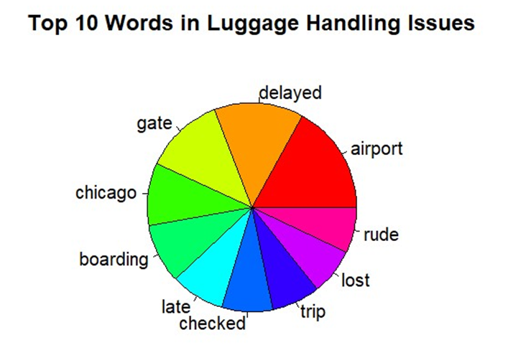
Software – Part 8 (Top 10 words mentioned with Negative Sentiment w.r.t. Luggage handling issues for United Airlines) – [Screenshot from R]

Slide 19
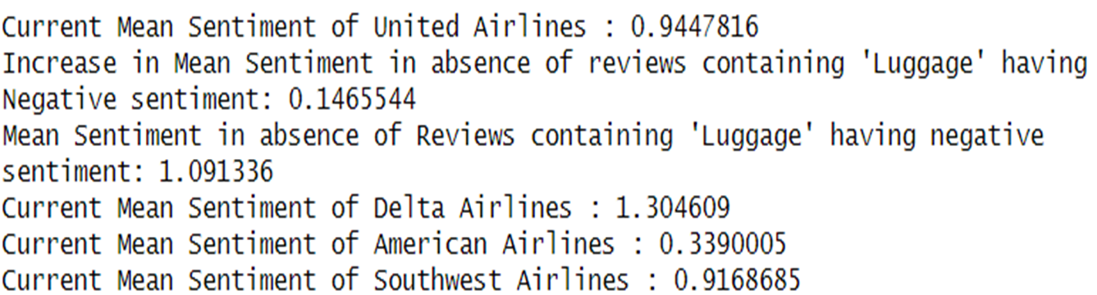
Model Results – Part 1: Showing current mean sentiment of United Airlines, its competitors and also the increase in mean Sentiment in absence of Reviews mentioning “Luggage” with negative Sentiment

Slide 20
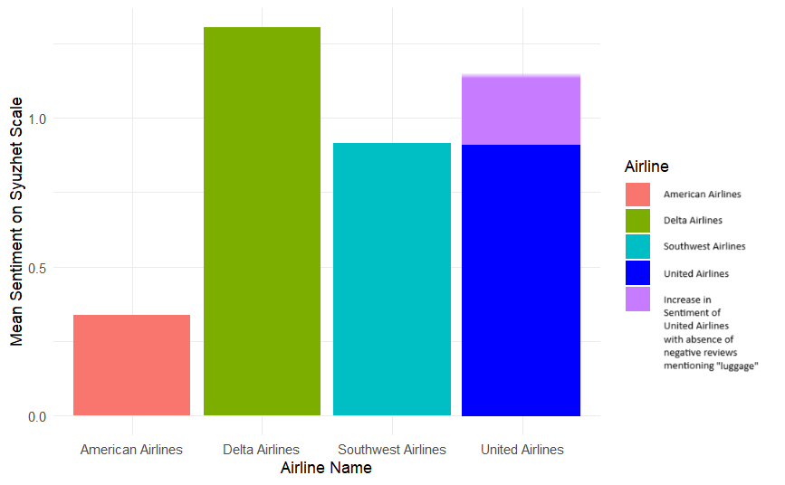
Model Results – Part 2: On a bar chart, Showing current mean sentiment of United Airlines, its competitors and also the increase in mean Sentiment in absence of Reviews mentioning “Luggage” with negative Sentiment for United Airlines.

Slide 21
Model Visualizations: Part 1 – How “luggage” is being mentioned with negative sentiment over Years for United Airlines
Notes:
notes

Slide 22
Model Visualizations – Part 2: (Luggage mentions over Years for Delta vs. American vs. Southwest Airlines)

Slide 23
Model Visualizations: Part 3: T-test results: Difference in Overall_Rating range when “Luggage” wasn’t mentioned (Class-1) versus when “Luggage” was mentioned (Class -2)

Slide 24
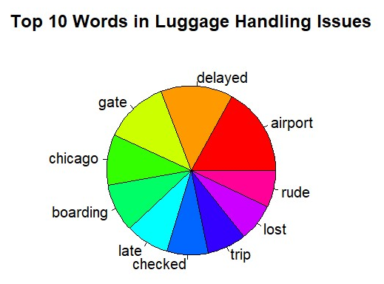
Model Visualization: Part 4 - After analyzing reviews mentioning “luggage” with a negative sentiment, these were the top 10 most frequently mentioned words, highlighting top factors causing the luggage handling issues:

Slide 25
Results Interpretation
Thus, we see that United Airlines has a problem with its Baggage Handling that is causing Negative sentiment among its Customers in an increasing manner over the years.
This trend is not found with other competing Airlines with similar market share such as Delta Airlines, American Airlines or Southwest Airlines.
This suggests that Luggage handling problems are unique to United Airlines and not rectifying them would result in declining market share for United Airlines.
Current mean sentiment of United Airlines is 0.9447816, measured on the Syuzhet scale. In the absence of Reviews mentioning “luggage” with negative sentiment, there is an increase of mean Sentiment of reviews posted on AirlineQuality.com to 1.091336.
The competitor airlines Delta, American and Southwest Airlines have 1.304609, 0.3390005, 0.9168685 respectively, suggesting that if the luggage handling issues are resolved, mean Sentiment on AirlineQuality.com will be improved and thus Brand Recognition of United Airlines can sustain and eventually overtake its competitors..
Notes:
notes

Slide 26
Situation Comparison
We compared these results against the competing Airlines which have an equivalent dominant market share, such as Southwest Airlines, American Airlines, Delta Airlines.
Unlike United Airlines, these Airlines do not have an increasing Negative sentiment among Customers with respect to their Luggage handling systems.
Over the past 4 years, only United has had an increase in Reviews mentioning “Luggage” with a negative sentiment, increasing each year by 5, while for other Airlines have seen drops in it, such as Delta by a decrease of 6, American by 26, Southwest by 19.
This suggests that Luggage handling problems are unique to United Airlines and not rectifying them would result in declining Brand Recognition for United Airlines.
Notes:
notes

Slide 27
Conclusion
Problem Solved: We see that United Airlines has a unique problem with its Baggage Handling that is causing Negative sentiment among its Customers in an increasing manner over the years.
The word “luggage” has been mentioned with a negative sentiment increasingly over the past 4 years.
We also notice that the reviews mentioning “luggage”, irrespective of its sentiment have a low average Overall_Rating over reviews that don’t mention “luggage” as seen by the t-test results interpreted by the boxplot.
More importantly, the Current Mean Sentiment of United Airlines: 0.9447816
Increase in Mean Sentiment in absence of reviews containing 'Luggage' having Negative sentiment: 0.1465544
Mean Sentiment for United in absence of Reviews containing 'Luggage' having negative sentiment: 1.091336
Current Mean Sentiment of Delta Airlines: 1.304609; Current Mean Sentiment of American Airlines: 0.3390005
Current Mean Sentiment of Southwest Airlines: 0.9168685
Lessons Learnt:
Importance of increasing Customer sentiment on AirlineQuality.com to improve Brand Recognition.
When United Airlines rectifies this issues flagged here, and follows the Recommendations, they will see an increase to at least 1.091336 in the mean Sentiment, which would stop its dropping negative sentiment due to its luggage handling issues, and sustain its Brand Recognition among its competitors.
Notes:
notes

Slide 28
Recommendation
Based on analyzing the reviews with negative sentiment w.r.t. Luggage handling and study by (Athreya, Kumar, 2024), these are the top factors causing distress to customers & suggested remedial measures:
Refunds are running late or never given - Refunds after claim should not be more than 20 days, work with bank providers and internally.
No updates on lost bags - If passenger claims the bags are lost, update them timely with assurances or future measures. The customer care wait time must be decreased to less than 30 mins. (Reviews say that some waited up to 4 hours)
Charging for Carry-on bags checked in at the gate - If the offer was to check in carry on bags free of charge as flight storage is full. Credit cards should not be charged for the same.
Better compensations - A person losing the bags and a person losing bags with delayed flights must be compensated fairly and differently. The number of receipts that can be submitted for reimbursements must be increased to 20 (currently it is 10) while claiming for reimbursements.
Cleaner dialogue by ground staff - Complaints on ground staff's service are greater in numbers, either passengers are informed incorrectly or generally ignorant. Hiring more employees to serve better and re-training of employees frequently.
Notes:
notes

Slide 29
References
Matousek, M. (2018, March 16). United Airlines’ worst customer service incidents - Business Insider. Business Insider; Business Insider. https://www.businessinsider.com/united-airlines-worst-customer-service-incidents-2018-3
Zhou, L. (2022, April 25). Research on quantitative model of brand recognition based on sentiment analysis of Big Data. Frontiers. https://www.frontiersin.org/articles/10.3389/fpsyg.2022.915443/full
Image reference: https://www.cntraveler.com/story/united-airlines-expansion-asia-pacific
Gopinath, S., Thomas, J., and Krishnamurthi, L. (2014). Investigating the relationship between the content of online word of mouth, advertising, and brand performance. https://www.researchgate.net/publication/276014170_Investigating_the_Relationship_Between_the_Content_of_Online_Word_of_Mouth_Advertising_and_Brand_Performance
Al Balawi, R., Hu, Y., Qiu, L. (2022). Brand crisis and customer relationship management on social media: evidence from a natural experiment from airline Industry. Elsevier. https://papers.ssrn.com/sol3/papers.cfm?abstract_id=4026514
Athreya, V., Kumar, A., (2023) A Study On Customer Satisfaction On Baggage Handling Services https://www.eurchembull.com/uploads/paper/c170e0f5389fc9136af1b81f474167b1.pdf

